Slide 1
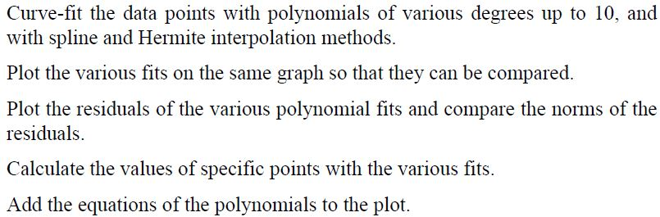
The Basic Fitting Interface
The basic fitting interface is a tool that can be used to perform curve fitting and interpolation interactively.
By using the interface the user can:

Slide 2
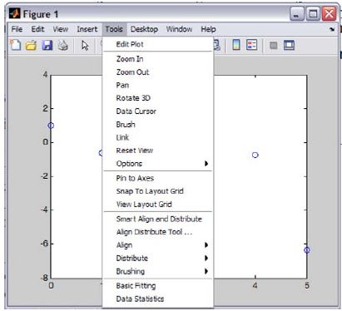
To activate the basic fitting interface, the user first has to make a plot of the data points. Then the interface is activated by selecting Basic Fitting in the Tools menu, as shown on the right. This opens the Basic Fitting Window.
When the window first opens, only one panel (the Plot fits panel) is visible. The window can be extended to show a second panel (the Numerical results panel) by clicking on the → button. One click adds the first section of the panel, and a second click makes the window look as:

Slide 3
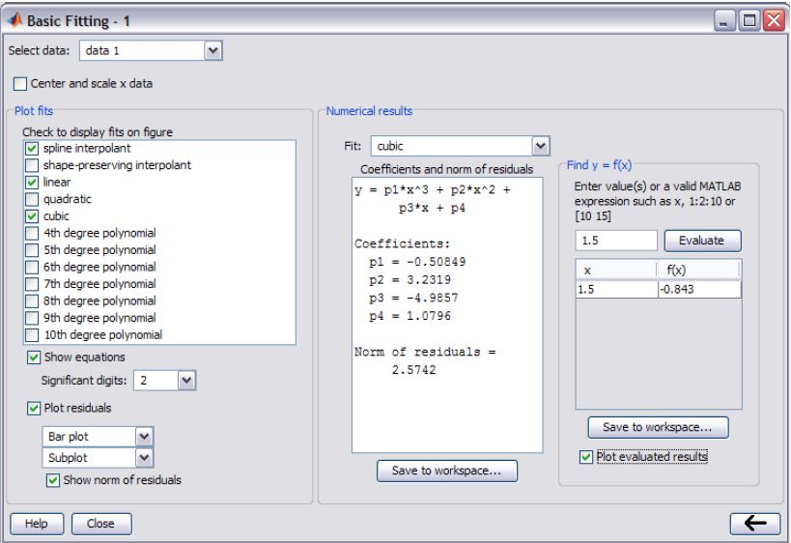
window can be reduced back

Slide 4
Select data: Used to select a specific set of data points for curve fitting in a figure that has more than one set of data points. Only one set of data points can be curve-fitted at a time, but multiple fits can be performed simultaneously on the same set.
Center and scale x data: When this box is checked, the data is centered at zero mean and scaled to unit standard deviation. This might be needed in order to improve the accuracy of numerical computation.

Slide 5
Four items are in the Plot fits panel and are related to the display of the fit.
Check to display fits on figure: The user selects the fits to be displayed in the figure. The selections include interpolation with spline interpolant (interpolation method) that uses the spline function, interpolation with Hermite interpolant that uses the pchip function, and polynomials of various degrees that use the polyfit function. Several fits can be selected and displayed simultaneously.
Show equations: When this box is checked, the equations of the polynomials that were selected for the fit are displayed in the figure. The equations are displayed with the number of significant digits selected in the adjacent sign menu.

Slide 6
Plot residuals: When this box is checked, a plot that shows the residual at each data point is created.
Choices in the menus include a bar plot, a scatter plot, and a line plot which can be displayed as a subplot in the same Figure Window that has the plot of the data points, or as a separate plot in a different Figure Window.
Show norm of residuals: When this box is checked, the norm of the residuals is displayed in the plot of the residuals.
The norm of the residual is a measure of the quality of the fit.
A smaller norm corresponds to a better fit.

Slide 7
Three items are in Numerical results panel
Fit: The user selects the fit to be examined numerically. The fit is shown on the plot only if it is selected in the Plot fit panel.
Coefficients and norm of residuals: Displays the numerical results for the polynomial fit that is selected in the Fit menu. It includes the coefficients of the polynomial and the norm of the residuals. The results can be saved by clicking on the Save to workspace button.
Find y = f(x): Provides a means for obtaining interpolated (or extrapolated) numerical values for specified values of the independent variable. Enter the value of the independent variable in the box, and click on the Evaluate button.
When the Plot evaluated results box is checked, the point is displayed on the plot.

Slide 8

Example
The following data points, which are points of the function
f(x) = 1.5^{x} cos(2x)
Use linear, spline, and pchip interpolation methods to calculate the value of y between the points. Make a figure for each of the interpolation methods.
In the figure show the points, a plot of the function, and a curve that corresponds to the interpolation method.

Slide 9
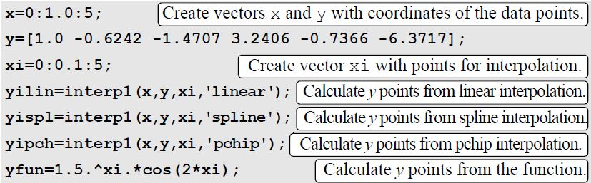
The following is a program written in a script file that solves the problem:

Slide 10
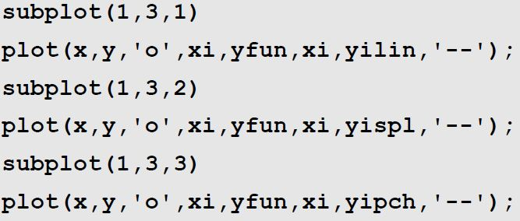

Slide 11
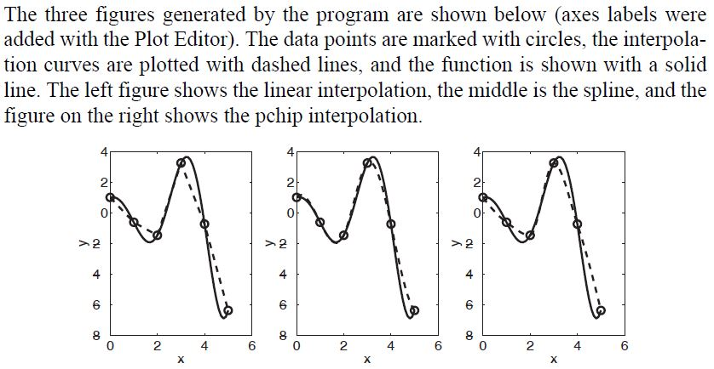

Slide 12
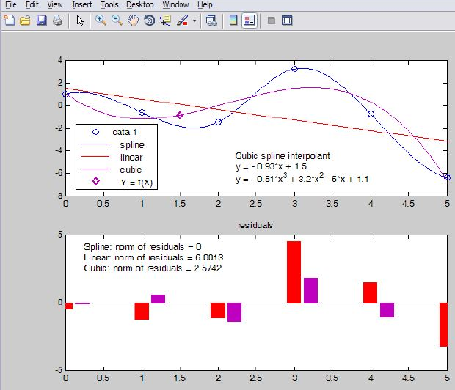
Figure Window includes a plot of the points, one interpolation fit (spline), two polynomial fits (linear and cubic), a display of the equations of the polynomial fits, and a mark of the point x = 1.5 that is entered in the Find y = f(x) box of the Basic Fitting Window. The Figure Window also includes a plot of the residuals of the polynomial fits and a display of their norm.

Slide 13
BIL 108E Introduction to Scientific and Engineering Computing
ASST. PROF. DR. İPEK AKIN
APPLICATIONS IN NUMERICAL ANALYSIS

Slide 14
INTRODUCTION
Numerical methods are commonly used for solving mathematical problems that are formulated in science and engineering where it is difficult or impossible to obtain exact solutions.

Slide 15
Solving an Equation with One Variable
f(x) = 0
The solution is a point where the function crosses or touches the x axis.
An exact solution is a value of x for which the value of the function is exactly zero. If such a value does not exist or is difficult to determine, a numerical solution can be determined by finding an x that is very close to the solution.
This is done by the iterative process, where in each iteration the computer determines a value of x that is closer to the solution. The iterations stop when the difference in x between two iterations is smaller than some measure. In general, a function can have zero, one, several, or an infinite number of solutions.

Slide 16
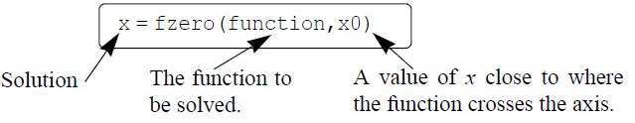
Solving an Equation with One Variable
A zero of a function can be determined with the command (built-in function) fzero with the form:

Slide 17
x is the solution, which is a scalar.
function is the function to be solved. It can be entered in several different ways:
1. The simplest way is to enter the mathematical expression as a string.
2. The function is created as a user-defined function in a function file and then the function handle is entered
3. The function is created as an anonymous function and then the name of the anonymous function (which is the name of the handle) is entered

Slide 18
The function has to be written in a standard form. For example, if the function to be solved is
xe^{-x} = 0.2
it has to be written as
f(x) = xe^{-x} - 0.2 = 0
If this function is entered into the fzero command as a string, it is typed as:
‘x*exp(-x)-0.2’
When a function is entered as an expression (string), it cannot include predefined variables. For example, if the function to be entered is
f(x) = xe^{–x} – 0.2
it is not possible to define b=0.2 and then enter ‘x*exp(-x)-b’

Slide 19
x0 can be a scalar or a two-element vector. If it is entered as a scalar, it has to be a value of x near the point where the function crosses (or touches) the x axis.
If x0 is entered as a vector, the two elements have to be points on opposite sides of the solution. If f(x) crosses the x axis, then f(x0(1)) has a different sign than f(x0(2)). When a function has more than one solution, each solution can be determined separately by using the fzero function and entering values for x0 that are near each of the solutions.

Slide 20
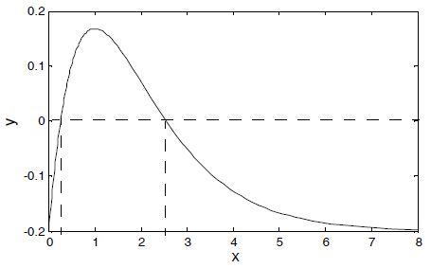
Example
Determine the solution of the equation xe^{–x} = 0.2 and plot the function.
The equation is first written in the form of a function:
f(x) = xe^{–x} = – 0.2
A plot of the function, shown on the right, shows that the function
has one solution between 0 and 1 and another solution between 2 and 3. The plot is obtained by typing

Slide 21
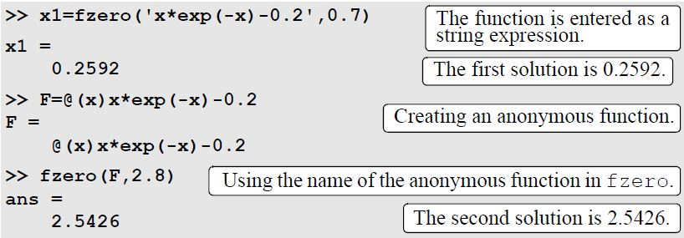
The solutions of the function are found by using the fzero command twice. First the equation is entered as a string expression, and a value of x0 between 0 and 1 (x0=0.7) is used. Second, the equation to be solved is written as an anonymous function, which is then used in fzero with x0 between 2 and 3 (x0=2.8).

Slide 22
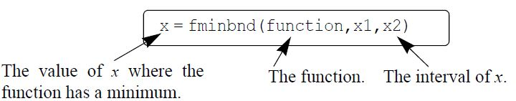
Finding a Minimum or a Maximum of a Function
In many applications there is a need to determine the local minimum or maximum of a function of the form y = f(x).
The value of x that corresponds to a local minimum or maximum is determined by finding the zero of the derivative of the function. The value of y is determined by substituting the x into the function. In MATLAB the value of x where a one-variable function f(x) within the interval x₁ ≤ x ≤ x₂ has a min can be determined with the fminbnd

Slide 23
The function can be entered as a string expression, or as a function handle, in the same way as with the fzero command
The value of the function at the minimum can be added to the output by using the option where the value of the function at x is assigned to the variable fval
Within a given interval, the minimum of a function can either be at one of the end points of the interval or at a point within the interval where the slope of the function is zero (local minimum).
When the fminbnd command is executed, MATLAB looks for a local minimum. If a local minimum is found, its value is compared to the value of the function at the end points of the interval. MATLAB returns the point with the actual minimum value for the interval.

Slide 24
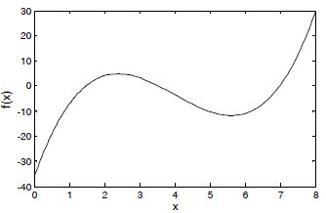
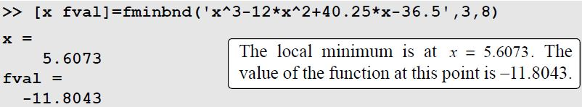
Consider a function
f(x) = x³ – 12x² + 40.25x – 36.5
plotted in the interval 0 ≤ x ≤ 8
Local minimum between 5 and 6, and that the absolute minimum is at x=0.
Using the fminbnd command with the interval 3 ≤ x ≤ 8 to find the location of the local minimum and the value of the function at this point gives:

Slide 25
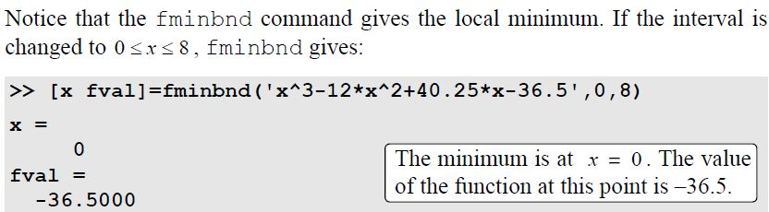
For this interval the fminbnd command gives the absolute minimum which is at the end point x=0.

Slide 26
